Slide 1

AN INTRODUCTION

Slide 2
Agenda
Why Spark
Difference between MR and Spark
  RDD and its relation to Spark.
Distributed Shared Memory
Spark Stack
Limitations

Slide 3
Spark enable distributed data processing through functional transformation on distributed collections of data.
- DataBricks

Slide 4
Why Spark ?
Modern distributed computing problem needs a programming abstraction that is better than map-reduce , an abstraction that wraps Map Reduce into a single concept.
A need for faster Hadoop to solve every distributed computing problem
A need to natively solve Iterative algorithms, a tough challenge to solve using only Map Reduce abstraction
To solve interactive data mining problems

Slide 5
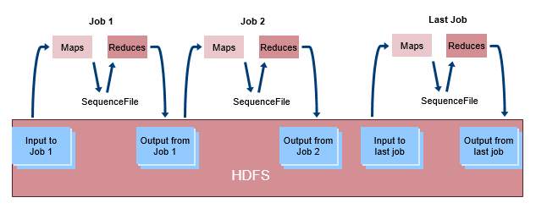
Iterative Operations on MapReduce

Slide 6

What are the Core Issues ?
The way we solve interactive and iterative algorithms is in-efficient, these in-efficiencies is a result of not keeping entire data in-memory.
keeping data in memory can improve efficiency for iterative algorithms as well as in interactive data mining.
The idea of SPARK ,especially RDD originated from this single thought.

Slide 7
What is the solution for this core issue then?
The solution is:
Provide a distributed memory abstraction that lets programmer perform in-memory computation on large clusters in a fault-tolerant manner.

Slide 8
Distributed Shared Memory :
  Hadoop has a good programming abstraction for accessing a clusters computational resource but have a very poor abstractions for leveraging distributed memory.
  Current distributed algorithms needs access to intermediate results of computation. They have to reuse intermediate results across multiple computation.
  Having distributed shared memory for intermediate results have its own issues as DSM are designed for fine grained updates to shared state which becomes bottleneck for algorithm that needs bulk update between computations.

Slide 9
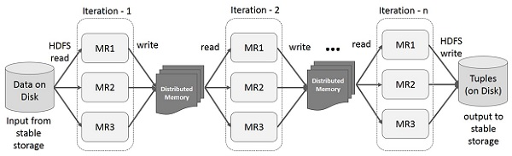
Iterative Operations on Spark RDD

Slide 10
Fine v/s Corse Grained Update:
Let us understand the difference between updates to memory which is mandate to comprehend RDD & Spark.
Assume we have billions of rows:
Some applications have to identify a unique record in billions of record and update them. Each update would be a different update logic. This is Fine Grained Update.
Update each record of billion records separately.
Some application would have a need to update all these billions of rows and apply the same update logic. Update billion recorded using same function is a Coarse Grained Update.

Slide 11
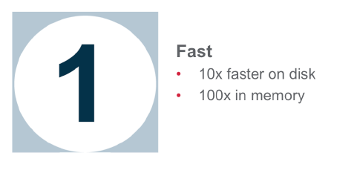
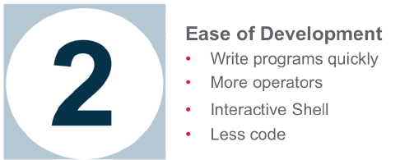
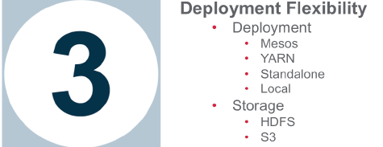
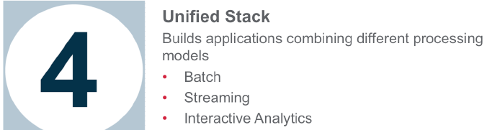
Why Spark

Slide 12
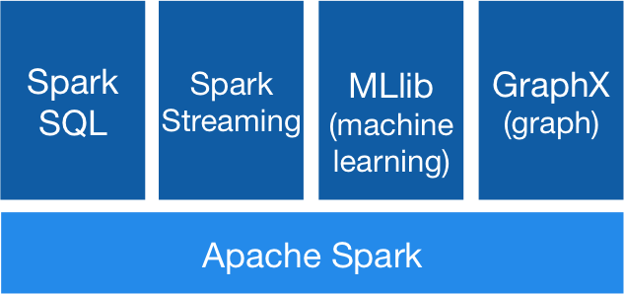
Spark Stack
Spark SQL
  For SQL and unstructured data processing
MLib
  Machine Learning Algorithms
GraphX
  Graph Processing
Spark Streaming
  stream processing of live data streams
http://spark.apache.org

Slide 13
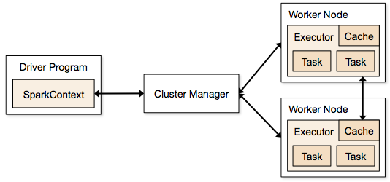
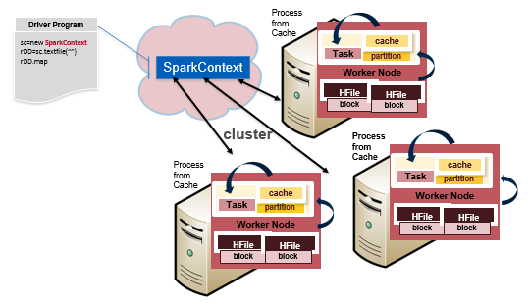
Execution Flow
http://spark.apache.org/docs/latest/cluster-overview.html

Slide 14
Terminology
Application Jar
  User Program and its dependencies except Hadoop & Spark Jars bundled into a Jar file
Driver Program
  The process to start the execution (main() function)
Cluster Manager
  An external service to manage resources on the cluster (standalone manager, YARN, Apache Mesos)

Slide 15
Terminology (contd.)
Worker Node : Node that run the application program in cluster
Executor
  Process launched on a worker node, that runs the Tasks
  Keep data in memory or disk storage
Task : A unit of work that will be sent to executor
Job
  Consists multiple tasks
  Created based on a Action
SparkContext :
  represents the connection to a Spark cluster, and can be used to create RDDs, accumulators and broadcast variables on that cluster.

Slide 16
Resilient Distributed Data
  Define RDD.
  RDD and its relation to Spark.
  RDD comparison with fine grained Distributed Shared Memory abstractions.
  RDD Limitation.

Slide 17
What is RDD?
RDD is a read only, partitioned collection of records.
It provides an abstraction for systems that need to load several dataset into memory and run ad-hoc query on them.
These are fault-tolerant, parallel data structure that allows users explicitly persist intermediate results in memory, and manipulate them using rich set of operators.
Resilient Distributed Dataset

Slide 18
RDD and Spark:
Relationship between RDD & Spark:
Spark exposes RDD through a language integrated API
Dataset are exposed as Objects and transformation(map, flat Map, etc) are invoked using methods on these objects.
RDD are defined as transformation like Map, Filter on data in a stable storage.
RDD are used to perform actions.
  The action can be an operation that returns a value to calling application or export data to storage system.
  Example for actions are like count, collect, save, etc.
An RDD can be persisted for future computation, RDD can be kept in memory or in disk

Slide 19
RDD v/s Distributed Shared Memory:
    Comparison between Distributed Memory(RDD)Abstraction
    with a Distributed Shared Memory:
In DSM, applications can read and write arbitrary memory locations in the global address space.
In RDD, a new RDD could be created as a result of transformation.

Slide 20
RDD Operations
Transformations
  Creation of a new dataset from an existing
    map, filter, distinct, union, sample, groupByKey, join, etc…
Actions
  Return a value after running a computation
    collect, count, first, takeSample, foreach, etc…
Check the documentation for a complete list
http://spark.apache.org/docs/latest/scala-programming-guide.html#rdd-operations

Slide 21
LIMITATION
Only to Batch applications: As RDD is designed for batch applications that apply same computation to all elements of dataset,
  it is less useful for application that makes asynchronous fine update to shared state, such as Database for web application or incremental web crawler.

Slide 22
Conclusion
Apache Spark framework helps with big data processing and analytics with its standard API.
We also looked at how Spark compares with traditional MapReduce implementation like Apache Hadoop.
You can also combine the Spark processing with Spark SQL, Machine Learning and Spark Streaming.
Resilient Distributed Dataset (aka RDD) is the primary data abstraction in Apache Spark and the core of Spark (that I often refer to as "Spark Core").

Slide 23
QUIZ
What is the solution for core issues in processing large IO intensive applications?
What is RDD
Difference between RDD and Shared Memory
What are the limitations of RDD
What are the responsibilities of a Worker Node

Slide 24
MCQ
Q.1 We can use Spark over Hadoop in-
Standalone
YARN
SIMR (Spark in MapReduce)
All of the above
Q.2 Which of the following is module for Structured data processing?
GraphX
MLlib
Spark SQL
Spark R

Slide 25
Q.3 Which of the following is not true for Apache Spark Execution?
To simplify working with structured data it provides DataFrame abstraction in Python, Java, and Scala.
The data can be read and written in a variety of structured formats. For example, JSON, Hive Tables, and Parquet.
Using SQL we can query data,only from inside a Spark program and not from external tools.
The best way to use Spark SQL is inside a Spark application. This empowers us to load data and query it with SQL.
Q.4 Which type of processing Apache Spark can handle
Batch Processing
Interactive Processing
Stream Processing
Graph Processing
All of the above

Slide 26
MCQ
Q.5 Which of the following statements are correct
Spark can run on the top of Hadoop
Spark can process data stored in HDFS
Spark can use Yarn as resource management layer
All of the above

